Slide 1
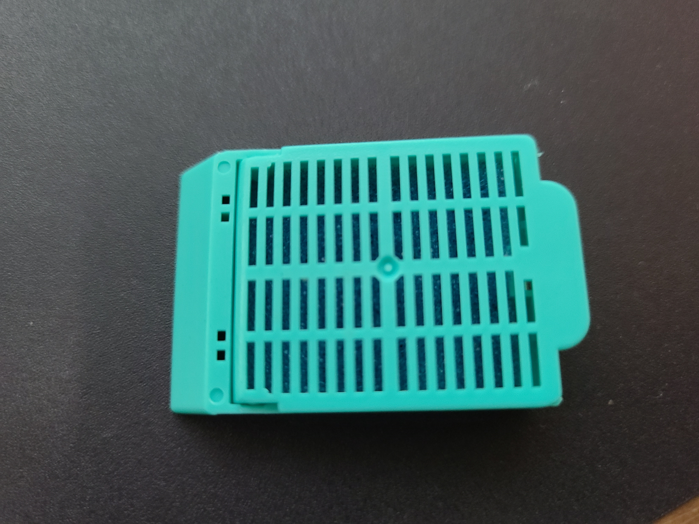
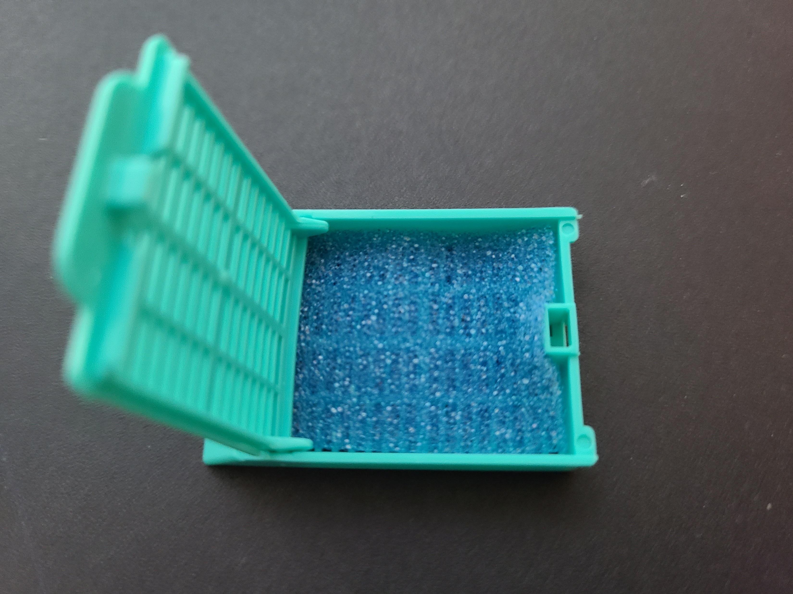
Pre-loaded cassette diagram
All samples are stored in PAXgene tissue stabilizer.
Service requested:
Embed samples in paraffin
Section, mount, and stain with H&E
Extra muscle tissue added for reference as to slide orientation
T1-4
T2
T1
T4
T3
Sample ID’s: each cassette is loaded with gonad cross-sections from four oysters (in this case T1, T2, etc.)
Gonad tissue is arranged top to bottom, from right to left
Foam spacer

